Slide 1
A Technological Framework for
Monitoring & Visualizing
Rock Deformation in Underground Mines
04/04/2025
Nilufer K. B. Akbulut, Dr. Angelina Anani
Notes:
1

Slide 2
AGENDA
Background
Aim & Objectives
The San Xavier Lab
Methodology
Results
Notes:
2

Slide 3
BACKGROUND
Notes:
17

Slide 4
SIGNIFICANCE
BURDEN, NEED, & IMPACT
29%
Percent of Ground Fall Fatalities in the Last Decade
Notes:
11

Slide 5
ROCK IN UNDERGROUND MINES
Rock Mass Behavior & Failures
SUDDEN vs
PROGRESSIVE
High Stress
Rock Movement
Mining-induced seismicity, Stress
Displacement, Strain, Closure
GROUND FALLS
SPALING
SQUEEZING
SWELLING
ROCK BURSTS
GRAVITY FAILURES
Notes:
12

Slide 6
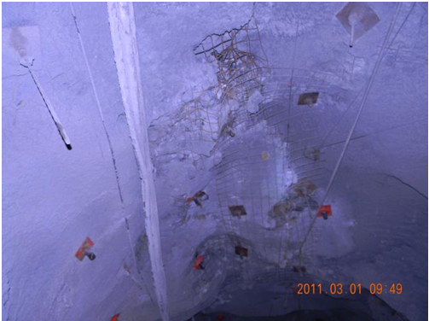
ROCK IN UNDERGROUND MINES
Rock Mass Behavior & Failures
Complex & Irregular
Outside Factors Disturbing the Rock Mass
MONITORING AND ASSESSMENTS
Hoek, 2006; Sandbak et al., 2020; Carri et al., 2021
Figure 1: Indicator of potential ground fall failure by Sandbak et al., 2020
Notes:
12

Slide 7
LITERATURE REVIEW
Geotechnical Monitoring Systems & Technologies in Underground Mining Environments
What is being done regarding monitoring tailored to underground mines?
Case Studies of Monitoring Implementation | Sun, 2009; Seymour et al., 2016
Development of New Sensor Technologies | Fuławka et al., 2022
Testing of New Sensor Technologies | Sun, 2009; Waclawik et al., 2017; Małkowski & Ostrowski, 2019; Skrzypkowski, 2020; Mai et al., 2021; Song et al., 2021;Liang et al., 2022
Comparative Studies of Instrumentations | Williams & Whyatt, 1992; Sun, 2009; Abdellah et al., 2014; Zhang et al., 2016; Sandbak et al., 2020; Rashed et al., 2021; Wang et al. 2021
Notes:
12

Slide 8
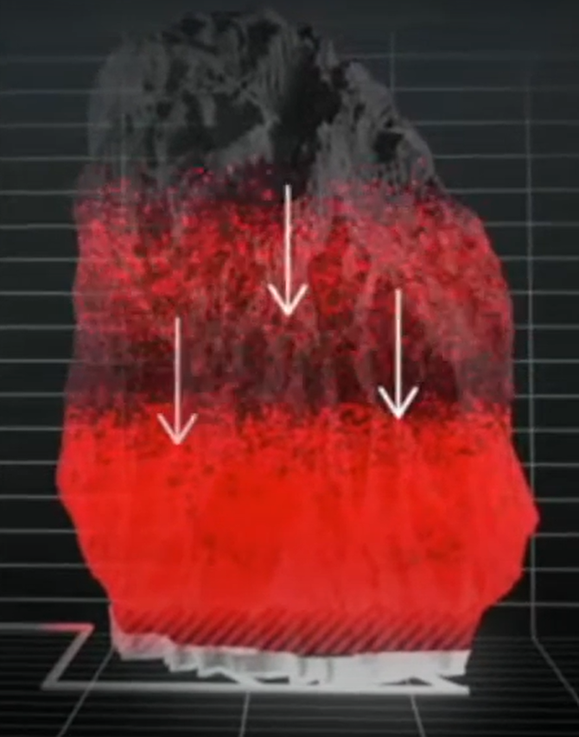
LITERATURE REVIEW
Geotechnical Monitoring Systems & Visual Analytics (VA)
Fragmentation Flow in Cave Mines
Seismic Monitoring Systems
Figure 2: Seismic data as glyphs around a 3D map of the mine by Seymour et al., 2016
Figure 3: Fragmentation flow visualization by fragment tracker sensors
Notes:
12

Slide 9
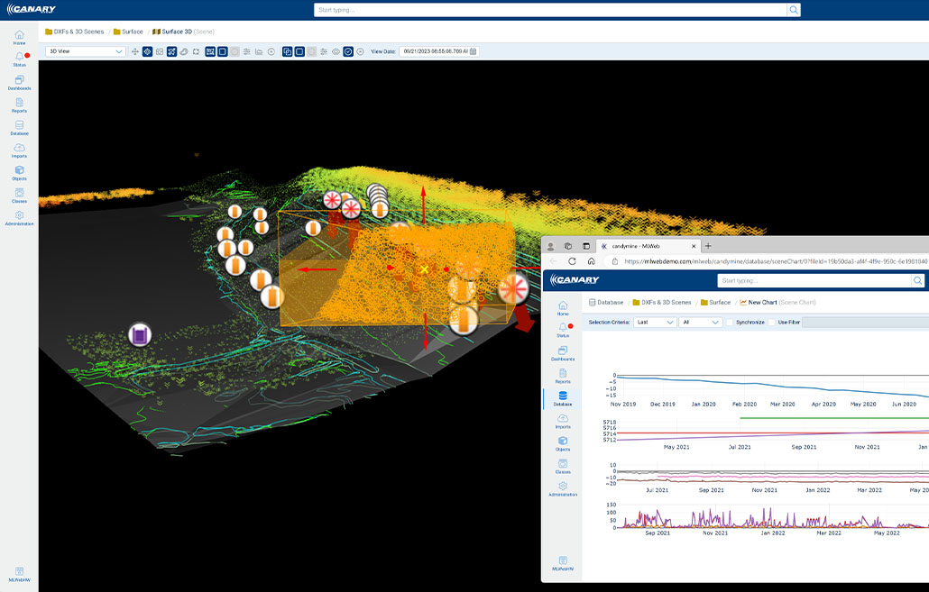
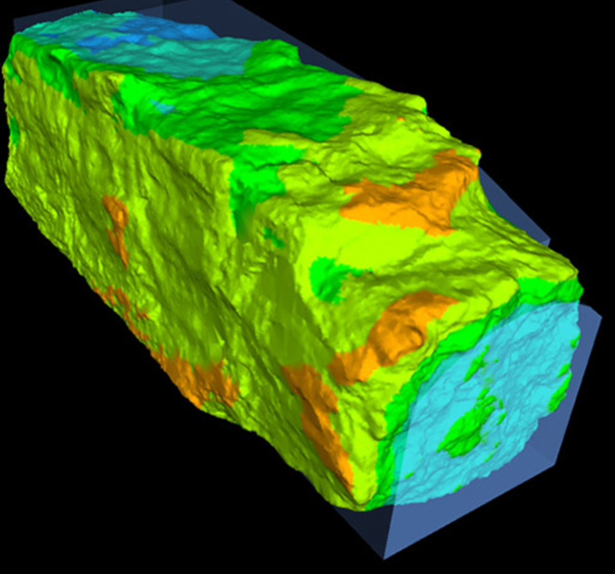
LITERATURE REVIEW
Geotechnical Monitoring Systems & Visual Analytics (VA)
Monitoring Solutions
Point Clouds
Figure 4: Various data visualization around an open pit mine by Canary systems
Figure 5: Displacement map with point cloud data by Point Studio Maptek
Notes:
12

Slide 10
LITERATURE REVIEW
GAP I
A systematic standard for geotechnical monitoring of underground mining environments
GAP II
Visual Analytics for monitoring data,
specifically for displacement

Slide 11
AIMS & OBJECTIVES
Addressing the NORA Goals
Notes:
17

Slide 12
OVERALL GOAL & OBJECTIVES
Develop a sensor-based automated monitoring network for the San Xavier (SX) experimental laboratory
Develop an ad-hoc data analysis and visualization tool for the interpretation of geotechnical sensor data
Build a graphical user interface for monitoring to display data and decision support
Develop A Technological Framework for Monitoring and Visualizing Rock Deformation in 3D
Notes:
11

Slide 13
SCIENTIFIC MERIT
INNOVATION
A framework that collects data automatically, remotely, and promptly
A visualization tool that stores, manages, and calculates data automatically
A visualization in 3D that allows information extraction directly
Proposing a comprehensive method for
Timely information extraction
Notes:
11

Slide 14
NORA GOALS
NORA OBJECTIVE 1.2: Integrate Engineering Controls into Mine Design to Reduce Risk
A geotechnical monitoring system & VA tool to assess ground behavior regularly, enabling timely actions
NORA OBJECTIVE 6.3: Integrate Operational Management into Advances in Engineering Designs to Improve Health & Safety
A VA tool to warn of risks and the associated space of the risk, increasing the safety of miners & engineers

Slide 15
THE SAN XAVIER
The Case Study
Notes:
17

Slide 16
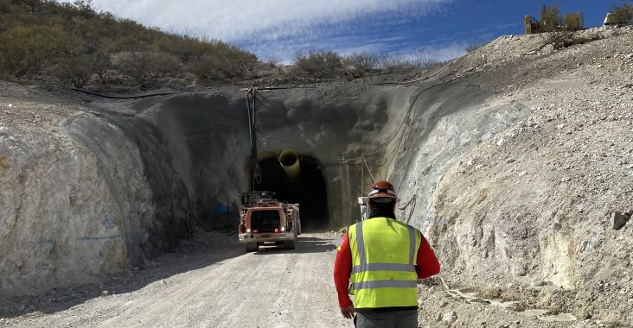
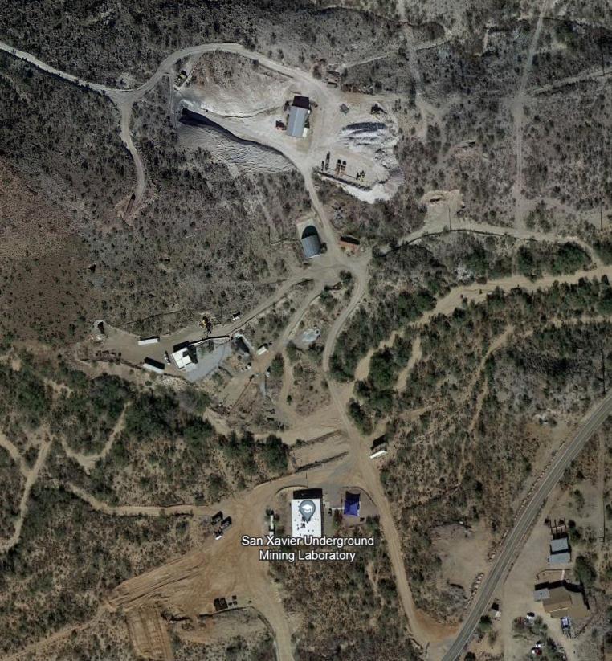
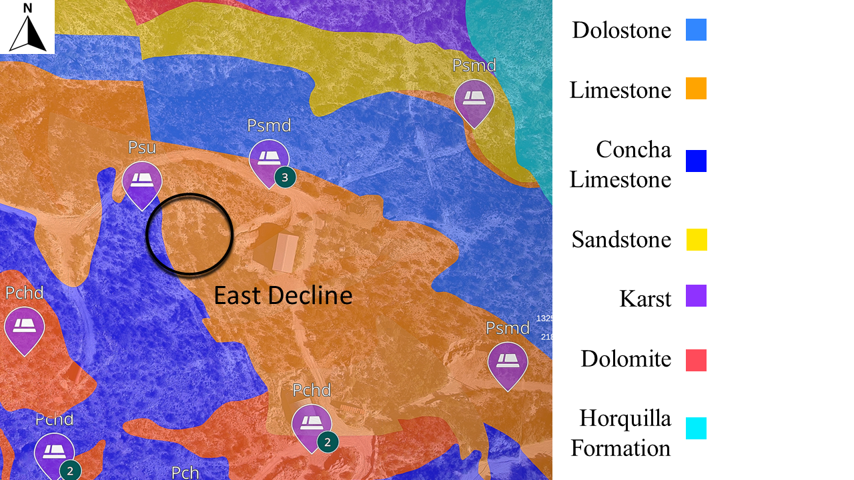
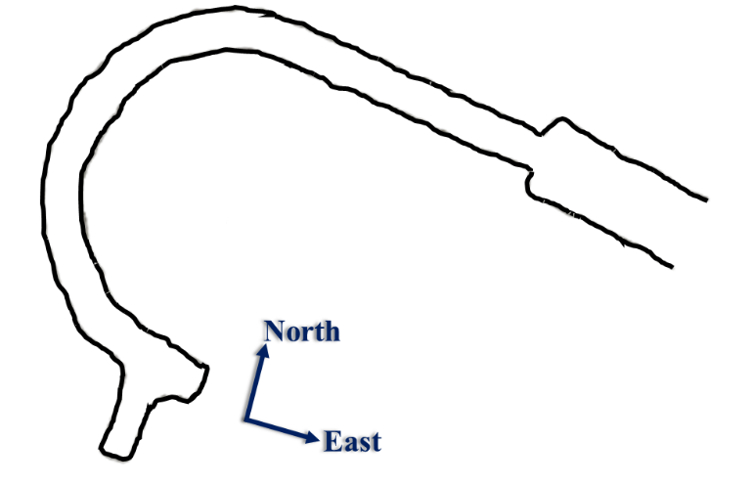
THE SX LABORATORY MINE
Figure 6: The portal entrance to the East decline at the SX
Figure 7: The outline of the East decline
Figure 5: The SX in plan view in Google Earth
Notes:
11

Slide 17
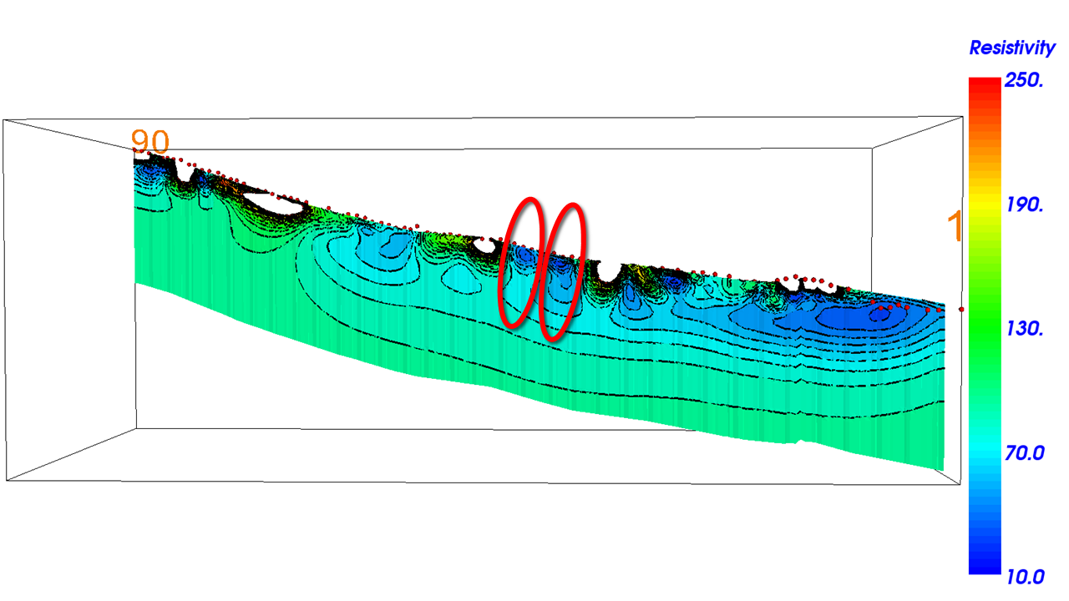
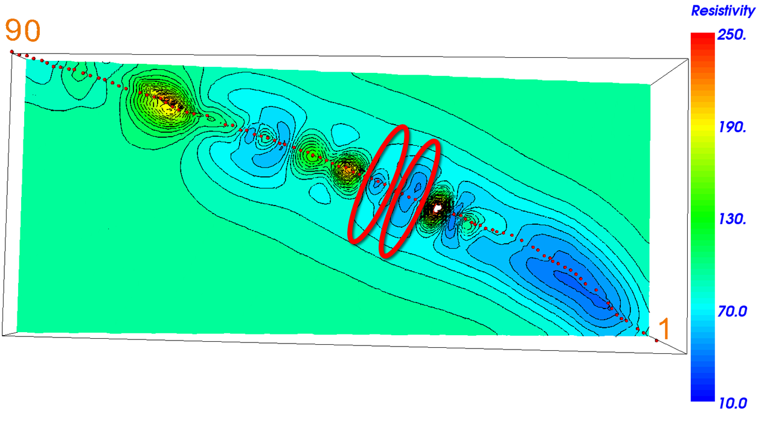
GEOLOGY & LITHOLOGY
Figure 9: Resistivity study result in side view
Figure 8: The geologic map surrounding the East decline
Figure 10: Resistivity study result in plan view
Notes:
11

Slide 18
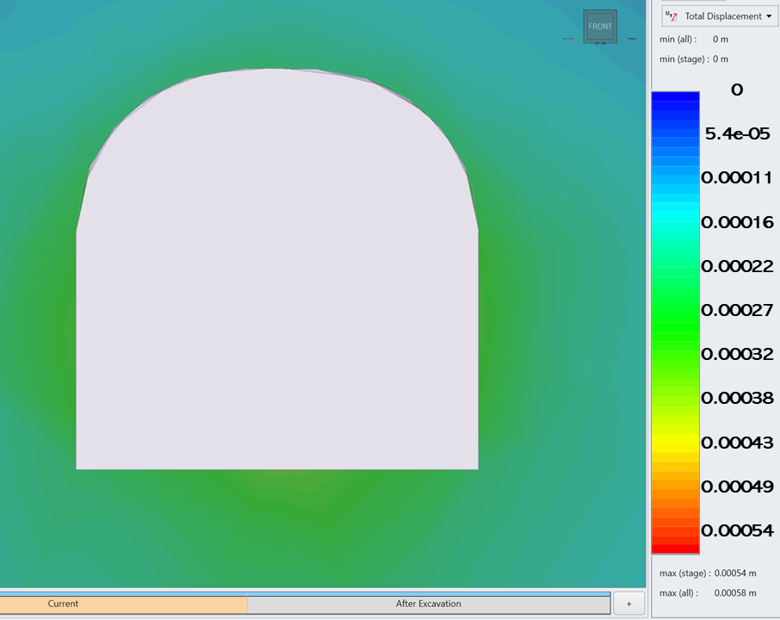
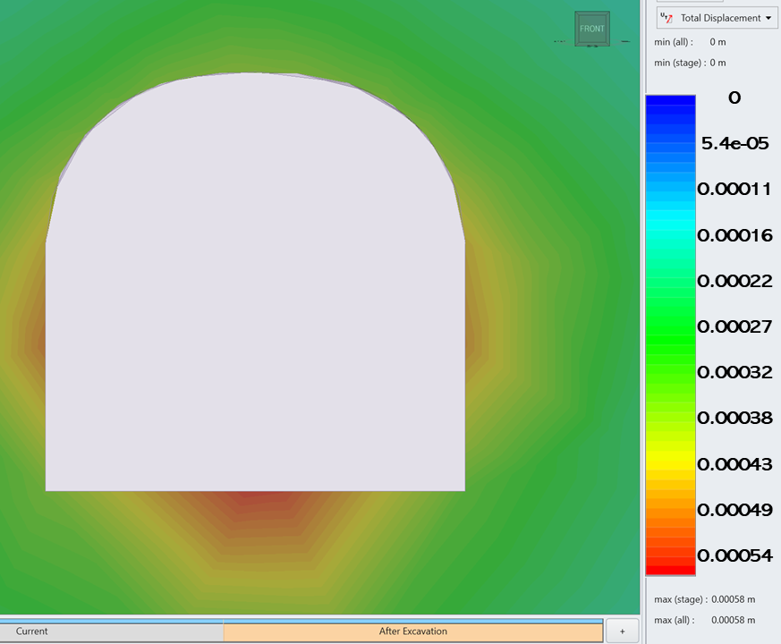
MECHANICAL PARAMETERS
Figure 11: RS3 results of potential displacement before excavation at the East decline
Rock Mass Data
Material | Elastic Brittle
Intact Rock UCS | 16 Mpa
Q-Index Value | 0.5 – 8 | FAIR
GSI | 45
Disturbance Factor | 0.8
Figure 12: RS3 results of potential displacement after excavation at the East decline
Notes:
11

Slide 19
METHODOLGY
HOW THE OBJECTIVES WERE ACHIEVED
Notes:
17

Slide 20
METHODOLOGY
Stage 1:
Monitored Variable(s)
Failure Types
Risk Matrix
Ground Conditions
Excavation Method
Stage 2:
Plan & Design
Instrumentation & Sensor Selection
Instrumentation Placement
Areas of Concern in Openings
DAQ System Design
Stage 3:
Installation
Preparation for Installations
Installation during operations
Cable Management
Wiring of Sensors
Stage 4:
Back-End
WiFi Settings
Data Pipeline Software Setup
Database Setup
API Setup
Data Display
Stage 5:
3D Mesh Generation
Vertex Information of Sensors
Displacement Data Retrieval
Heatmap Development
Notes:
1

Slide 21
DETERMINATION, PLAN, & DESIGN
Risk Matrix of the Ground Fall Before Excavations & After Excavations
Probability | Minor | Major | Critical | Catastrophic
Frequent
Probable
Occasional |  |  | Potential Ground Fall
Remote
Very Unlikely |  |  | Current Ground Fall
Severity

Slide 22
DETERMINATION, PLAN, & DESIGN
Instrumentations, Sensor Types, & Quantities Used for the Monitoring System at the SX
Instrument | Sensor | Number of Instrument | Number of Sensors per Instrument | Producer
MPBX | VW Transducer | 6 | 4 | Geokon
Instrumented Bolt | VW Strain Gauge | 9 | 1 | Geokon
Sun, 2009; Seymour et al., 2019; Sandbak et al., 2020 from Leeville Mine & Turquoise Ridge Gold Mine
Esterhuizen et al., 2018 from NIOSH & Longwall Coal Mining
Ariznavarreta-Fernández, 2018 for a Tunnel in Spain
Fuławka et al., 2018 from KGHM Copper Mine in Poland
Mai et al., 2021 from Finland at a Laboratory Mine
Sudhakar & Naik, 2020 for a Cavern in Himalayas
Skrzypkowski, 2020 from Polan Copper Mines
Wang et al., 2020 Review for Underground Monitoring Systems

Slide 23
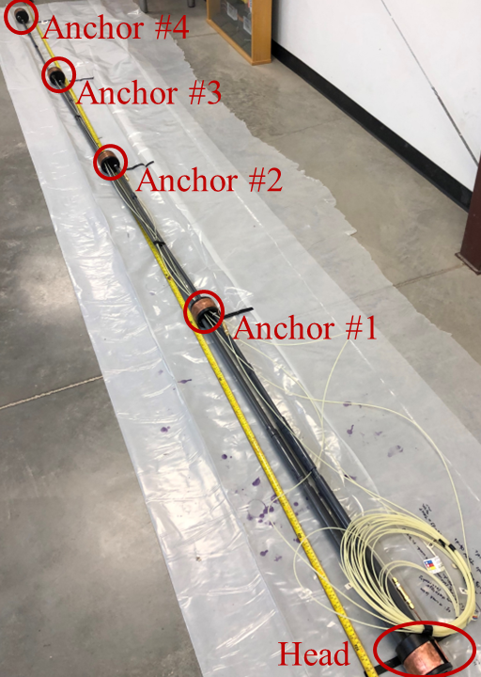
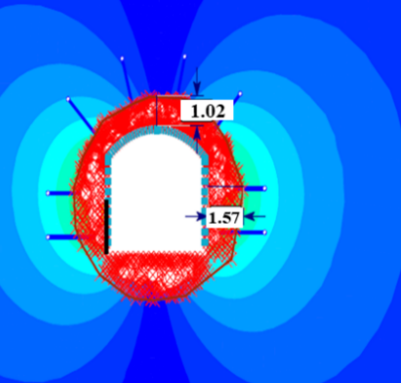

DETERMINATION, PLAN, & DESIGN – MPBXs
$$ΔU=u_{i}−u_{0}$$
For Each Anchor Point
Figure 14: RS2 results showcasing yield zone surrounding the excavation
Figure 13: MPBX built and laid out

Slide 24
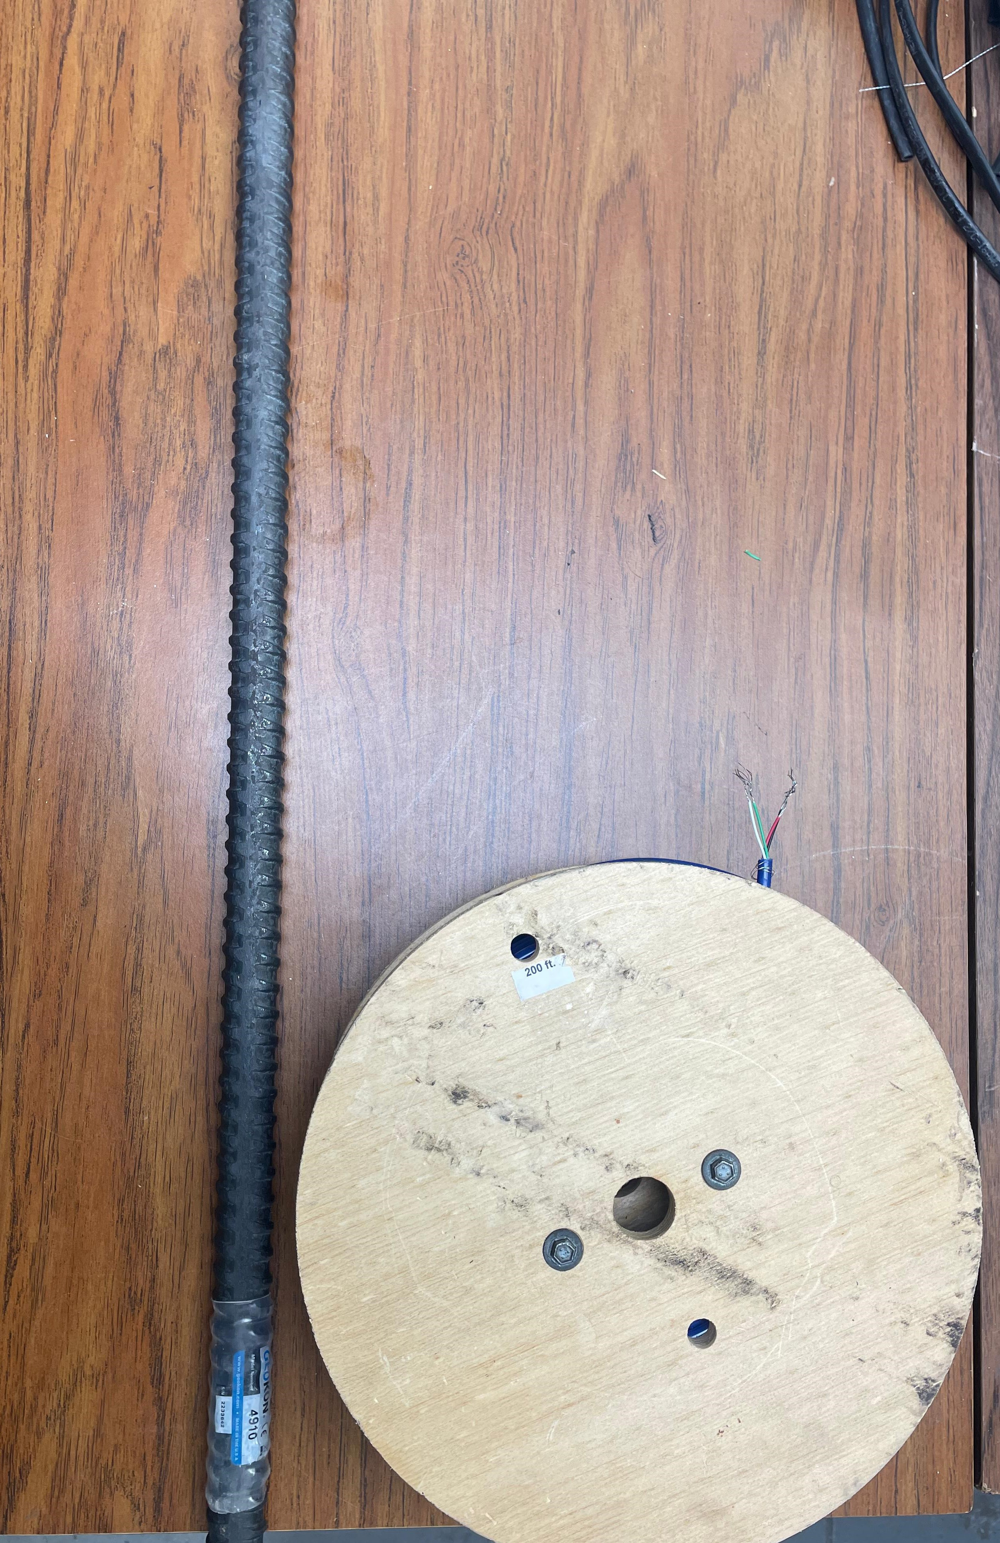
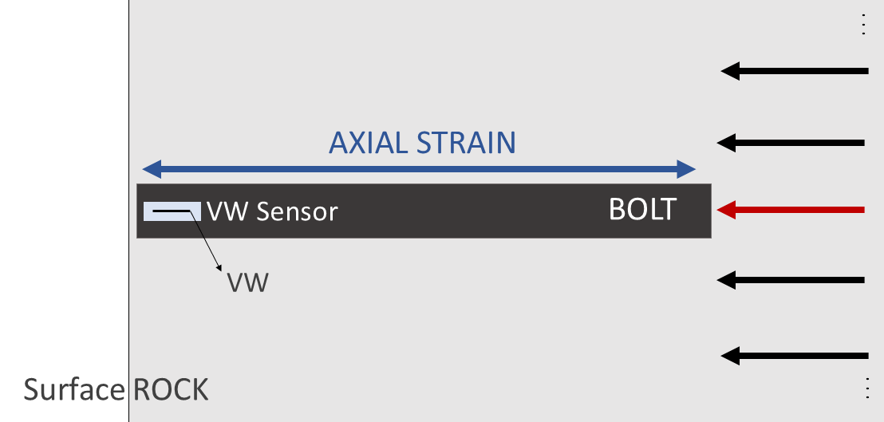

DETERMINATION, PLAN, & DESIGN – INSTRUMENTED BOLTS
Figure 16: Diagram of measured strain and displacement direction using instrumented bolts
$$Δε=ε_{i}−ε_{0}$$
For Each Bolt
Figure 15: Instrumented bolt and cable spool

Slide 25
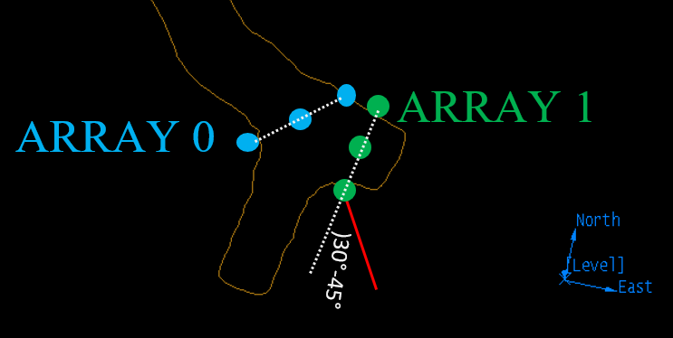
DETERMINATION, PLAN, & DESIGN – LAYOUT
Hudyma & Potvin, 2010
A0X1
A0X2
6 MPBXs Installed
9 Instrumented Bolts
to be
Installed
A1X1
A0X3
A2BOLTS
A1X2
A3BOLTS
A4BOLTS
A1X3
Figure 17: Plan view of instrumentation layout at the East decline near the advancing face

Slide 26
DETERMINATION, PLAN, & DESIGN – LAYOUT
A1X2
Advancing Face Profile
A1X1
A1X3
~6 m
) 5 °
~ 2 m
Figure 18: Profile view of instrumentation layout at the East decline near the advancing face

Slide 27
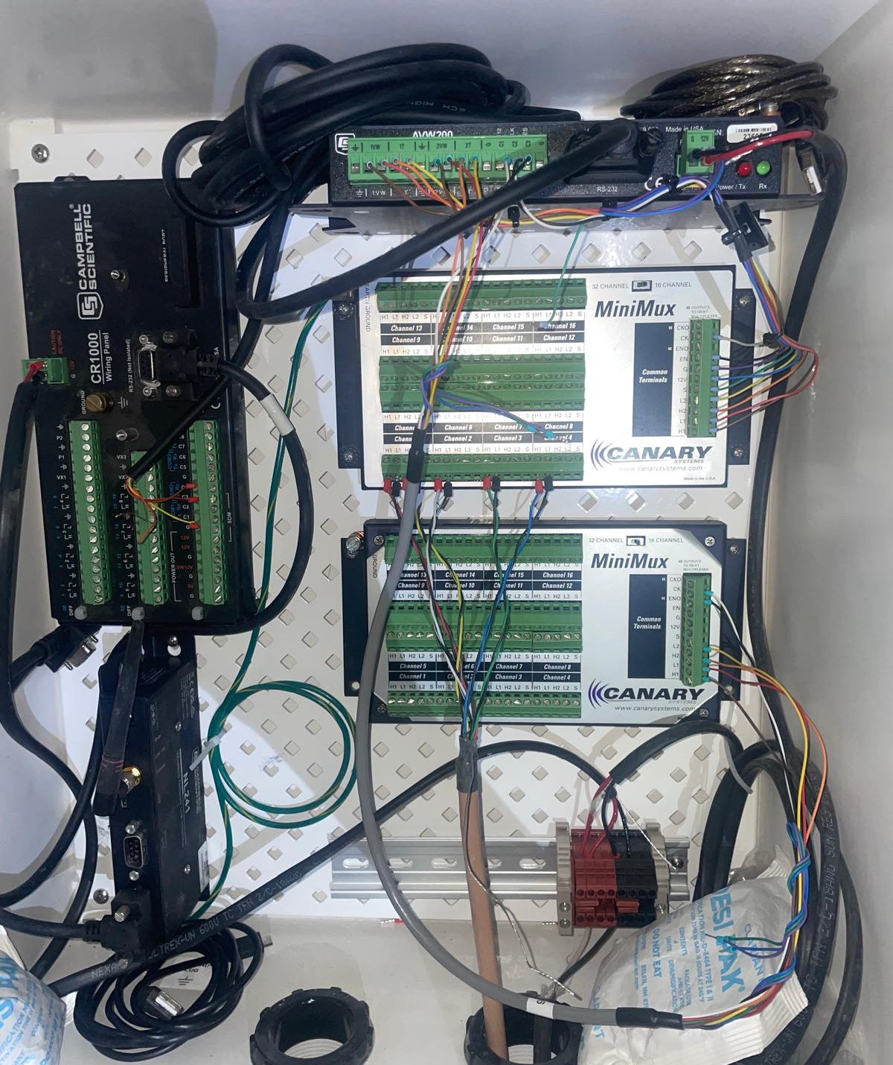
BACK-END DEVELOPMENT – DATA PIPELINE
Sensor Network
Data Collection System
WiFi Module
Instrumented Bolts
Multiplexer
MPBXs
VW Module
Data Logger
Power System
Figure 19: The automated wireless data acquisition hardware and wiring

Slide 28
METHODOLOGY
Stage 1:
Monitored Variable(s)
Failure Types
Risk Matrix
Ground Conditions
Excavation Method
Stage 2:
Plan & Design
Instrumentation & Sensor Selection
Instrumentation Placement
Areas of Concern in Openings
DAQ System Design
Stage 3:
Installation
Preparation for Installations
Installation during operations
Cable Management
Wiring of Sensors
Stage 4:
Back-End
WiFi Settings
Data Pipeline Software Setup
Database Setup
API Setup
Data Display
Stage 5:
3D Mesh Generation
Vertex Information of Sensors
Displacement Data Retrieval
Heatmap Development
Notes:
1

Slide 29
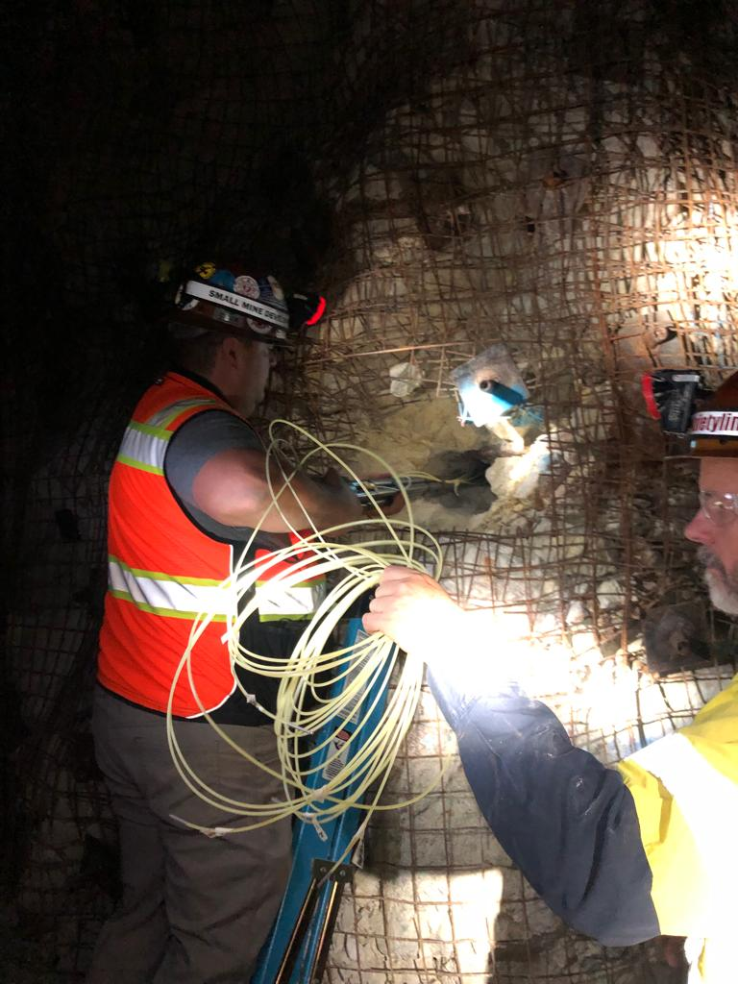
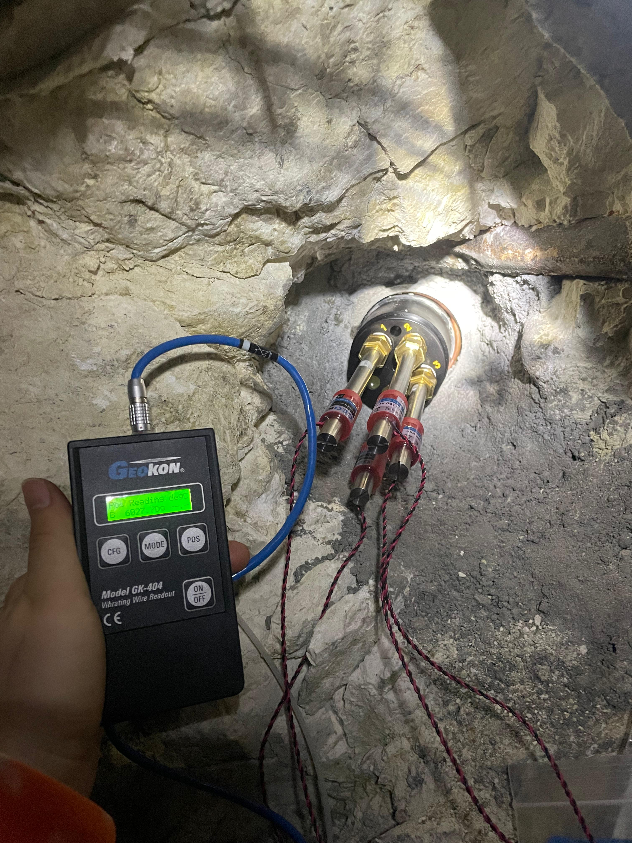
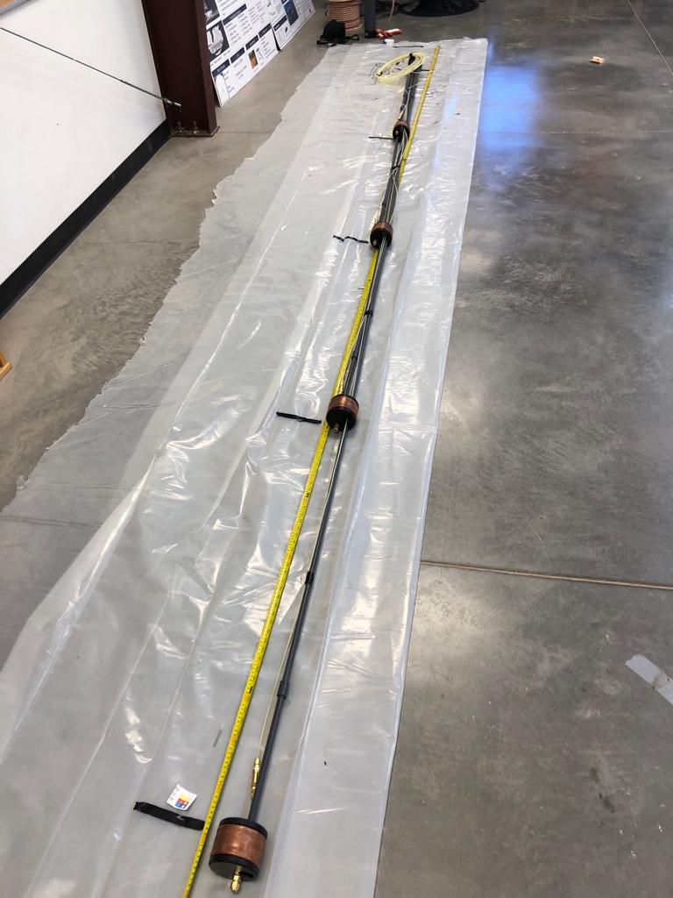
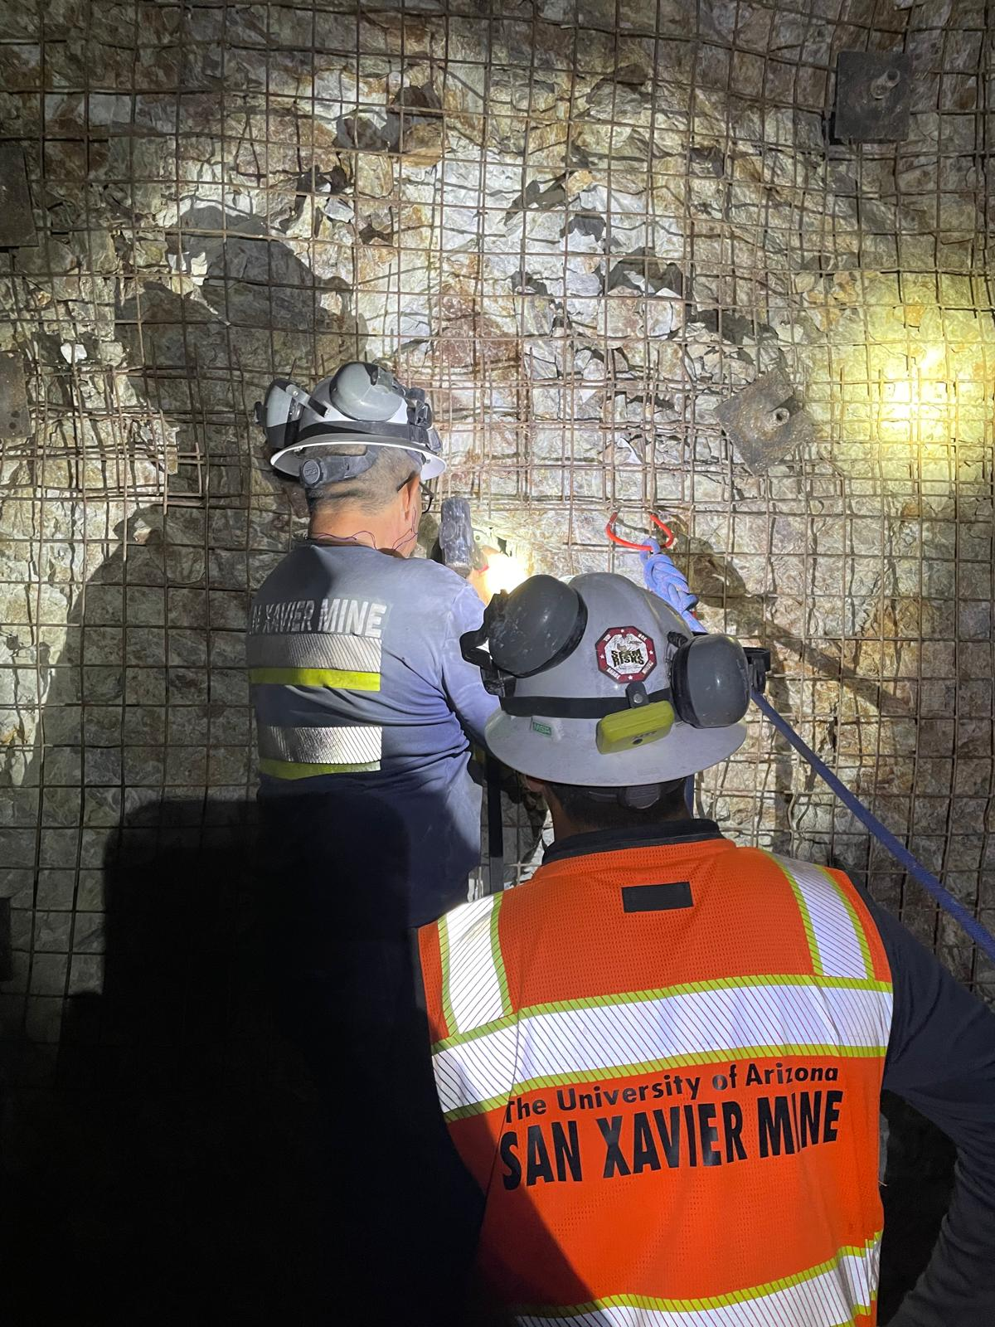
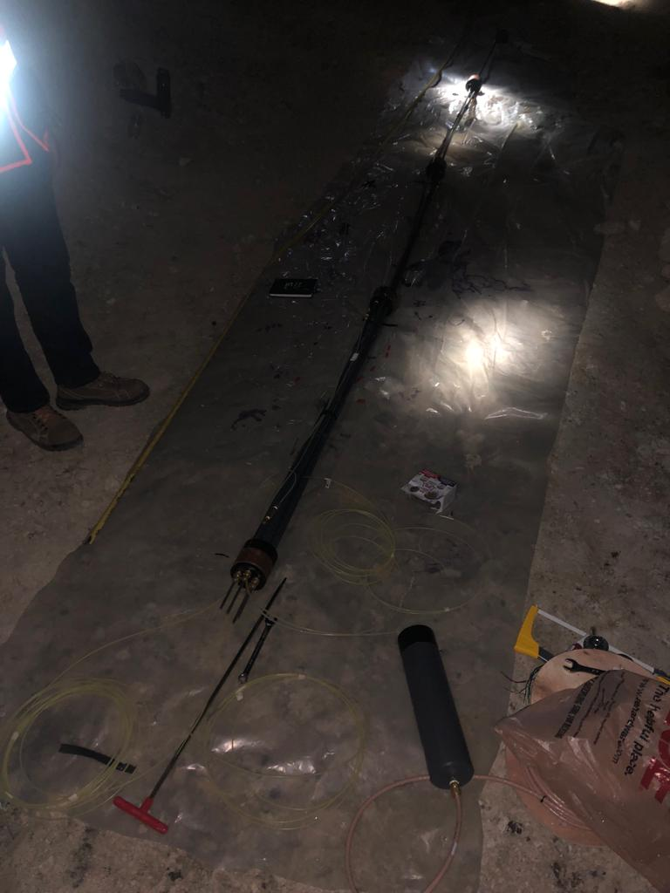
INSTALLATION – MPBXs
INSTALLATION KEYPOINTS
CONSIDERATIONS
Building the Instrument

Slide 30
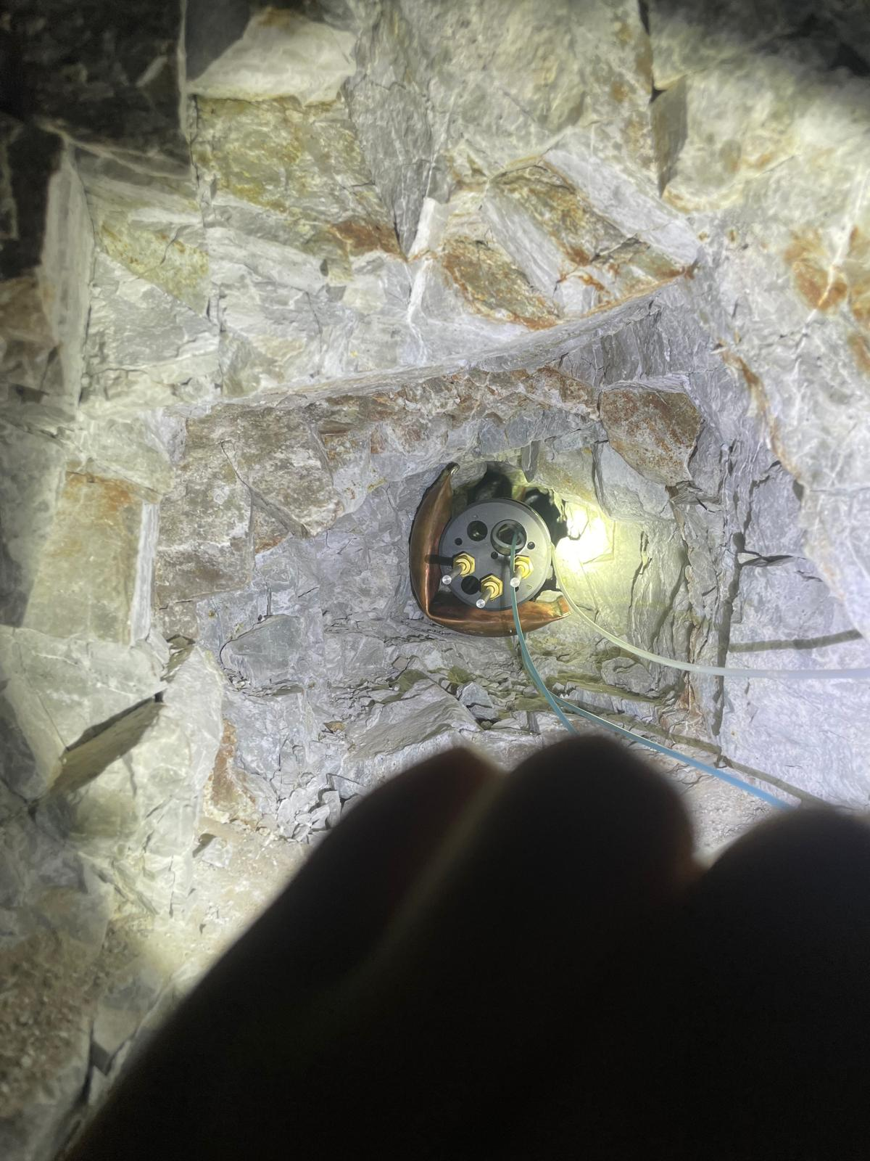
INSTALLATION – MPBXs
INSTALLATION KEYPOINTS
CONSIDERATIONS
Building the Instrument
Instrument Size vs Opening Size

Slide 31
INSTALLATION – MPBXs
INSTALLATION KEYPOINTS
CONSIDERATIONS
Building the Instrument
Instrument Size vs Opening Size
Lithology & Geology

Slide 32
INSTALLATION – MPBXs
INSTALLATION KEYPOINTS
CONSIDERATIONS
Building the Instrument
Instrument Size vs Opening Size
Lithology & Geology
Machinery & Equipment Maintenance

Slide 33
INSTALLATION – MPBXs
INSTALLATION KEYPOINTS
CONSIDERATIONS
Building the Instrument
Instrument Size vs Opening Size
Lithology & Geology
Machinery & Equipment Maintenance
Mining Cycle Downtime

Slide 34
INSTALLATION – MPBXs
INSTALLATION KEYPOINTS
CONSIDERATIONS
Building the Instrument
Instrument Size vs Opening Size
Lithology & Geology
Machinery & Equipment Maintenance
Mining Cycle Downtime
Resources
KEY TAKEAWAY: MONITORING INSTALLATION SHOULD BE PART OF MINE CYCLE

Slide 35
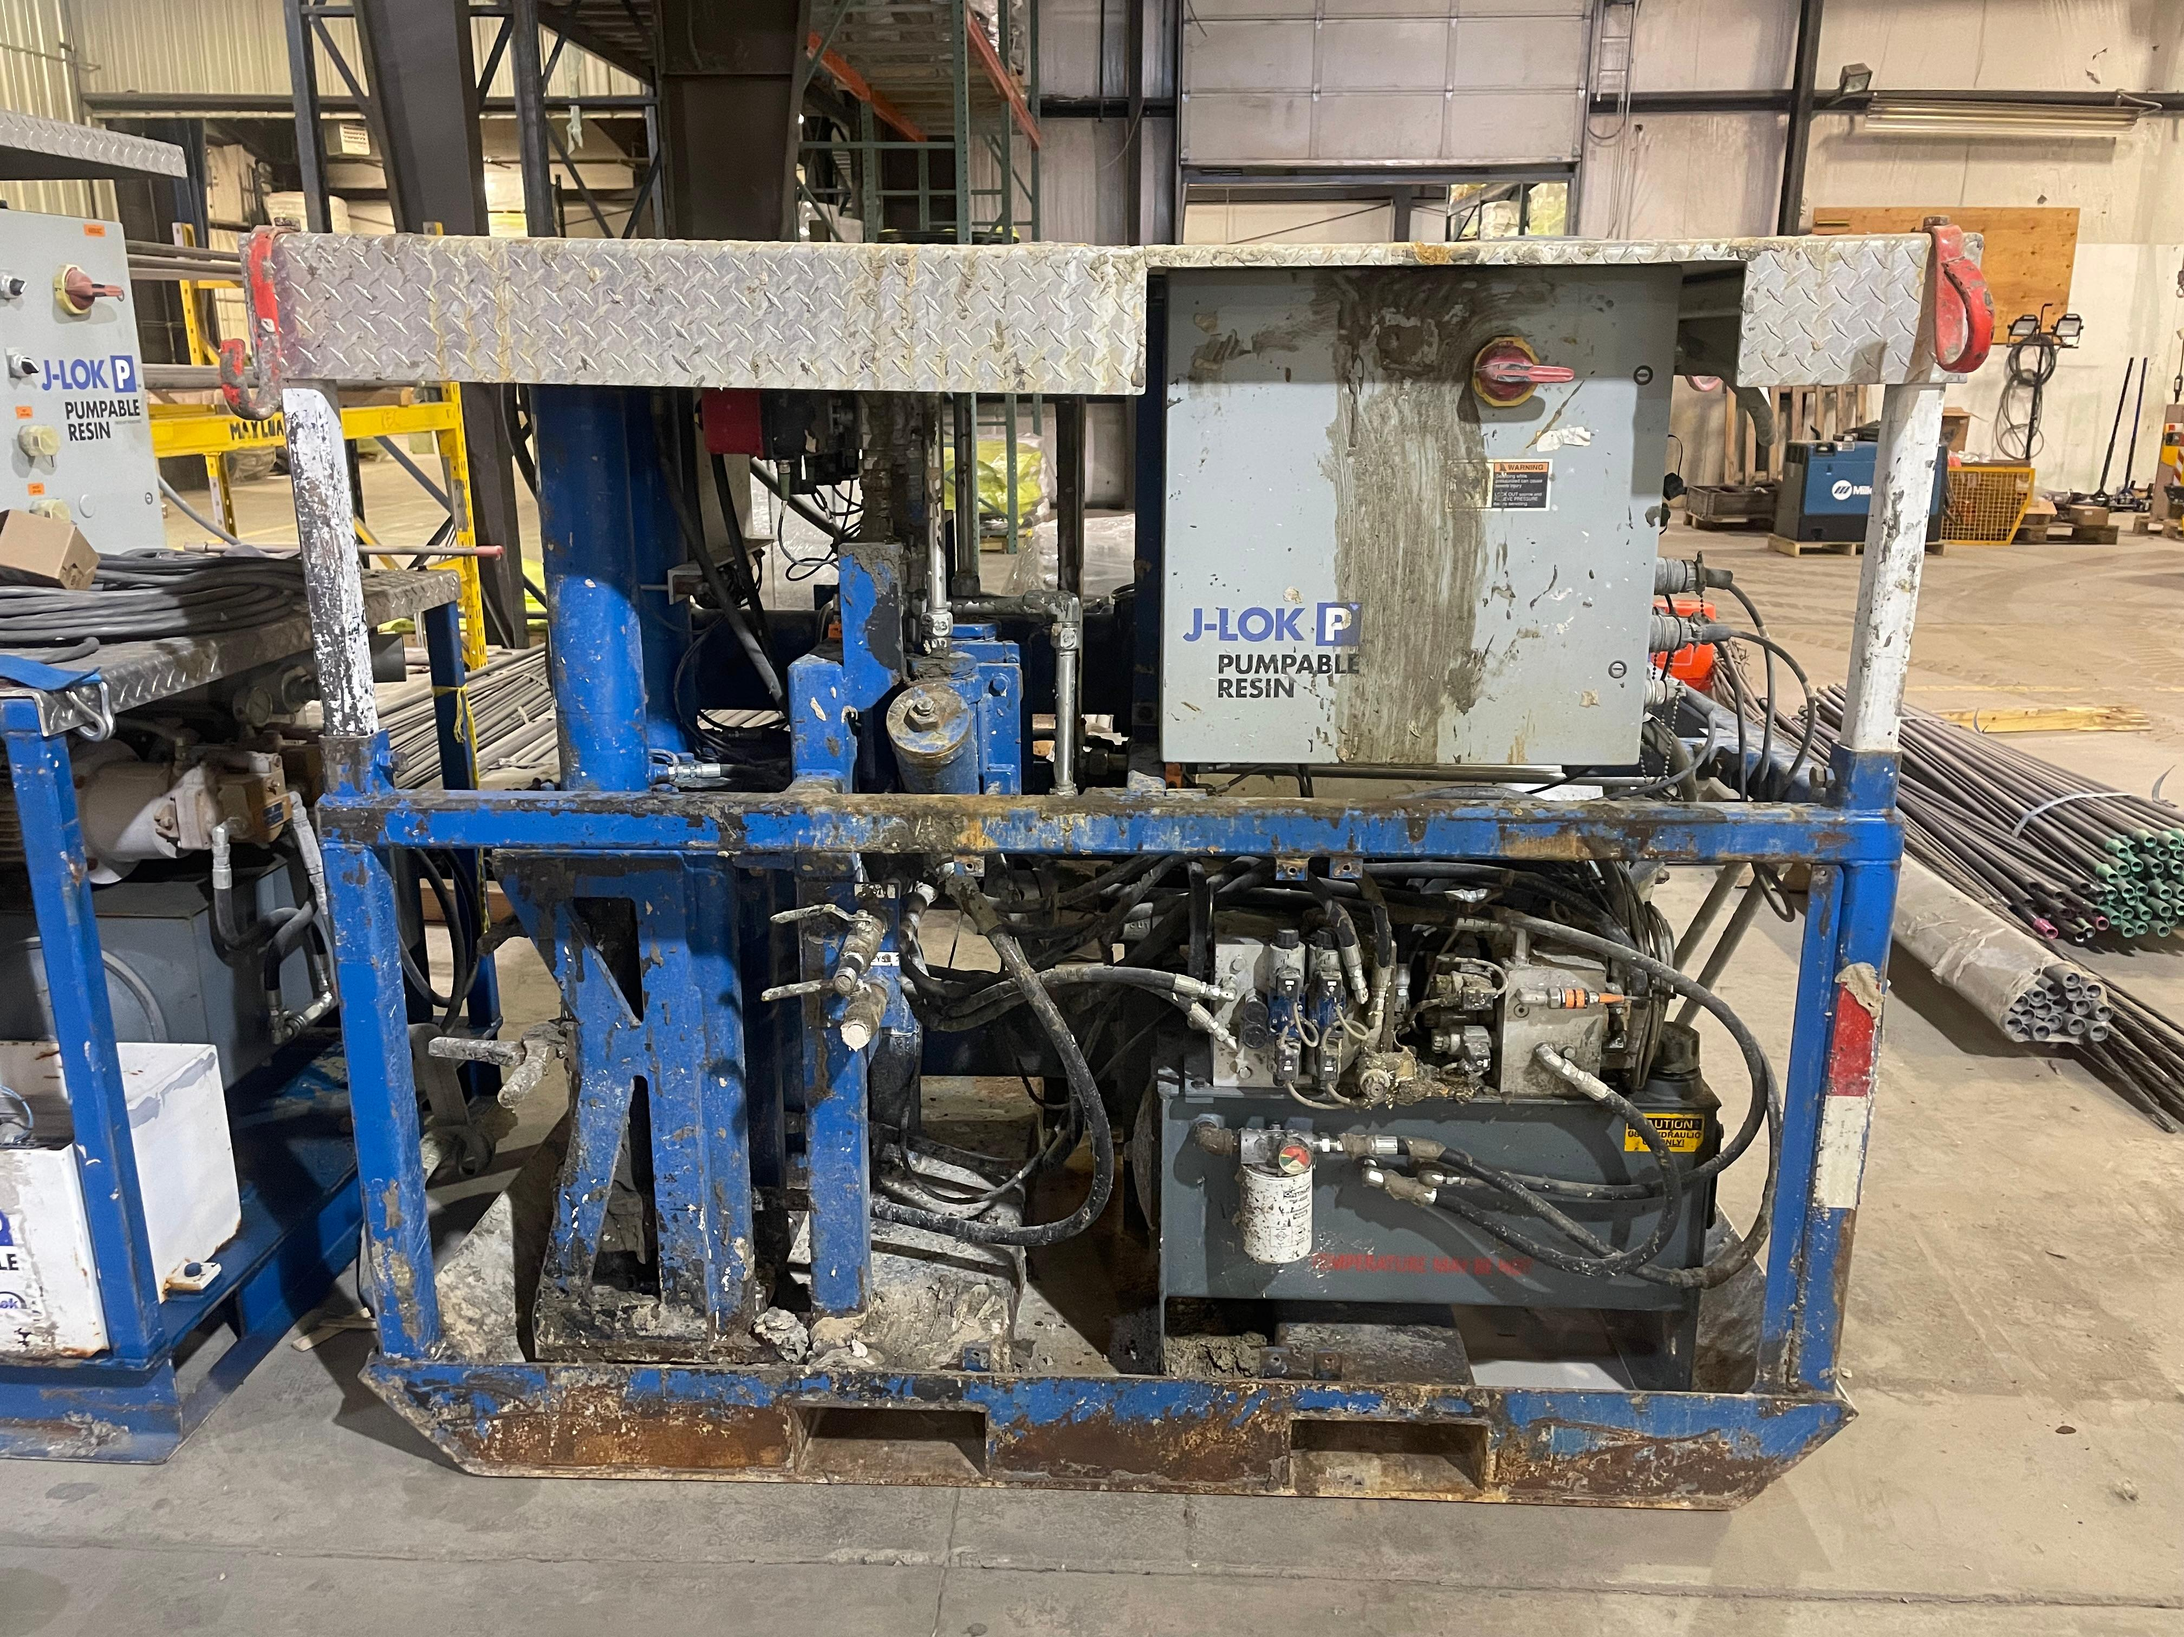
INSTALLATION – Instrumented Bolts
INSTALLATION KEYPOINTS
CONSIDERATIONS
Lithology & Geology
Machinery & Equipment Maintenance
Mining Cycle Downtime
Resources
KEY TAKEAWAY: WIRING AND CABLE MANAGEMENT CREW
Figure 20: Resin pump for bolt installation by Jennmar

Slide 36
METHODOLOGY
Stage 1:
Monitored Variable(s)
Failure Types
Risk Matrix
Ground Conditions
Excavation Method
Stage 2:
Plan & Design
Instrumentation & Sensor Selection
Instrumentation Placement
Areas of Concern in Openings
DAQ System Design
Stage 3:
Installation
Preparation for Installations
Installation during operations
Cable Management
Wiring of Sensors
Stage 4:
Back-End
WiFi Settings
Data Pipeline Software Setup
Database Setup
API Setup
Data Display
Stage 5:
3D Mesh Generation
Vertex Information of Sensors
Displacement Data Retrieval
Heatmap Development
Notes:
1

Slide 37






BACK-END DEVELOPMENT – DATA PIPELINE
Data Storage and Display
Sensor Network
Data Collection System
UNITY
WiFi Module
Instrumented Bolts
Multiplexer
RESTAPI
IoT
MPBXs
VW Module
Data Logger
Data Server
Azure Database
Power System

Slide 38
BACK-END DEVELOPMENT – DATA PIPELINE
RESTful API
GET data with
SQL Query
Event System &
EINumerator
DATABASE
-Raw Data
-Engineering Data
Query Most Recent Data
HTTP request
GET protocol
OR
UNITY
Query Weekly Data
Response Body
JSON
OR
Response Body
JSON
Query Monthly Data
De-serialize
JSON
Visualize Data
Shaders

Slide 39
METHODOLOGY
Stage 1:
Monitored Variable(s)
Failure Types
Risk Matrix
Ground Conditions
Excavation Method
Stage 2:
Plan & Design
Instrumentation & Sensor Selection
Instrumentation Placement
Areas of Concern in Openings
DAQ System Design
Stage 3:
Installation
Preparation for Installations
Installation during operations
Cable Management
Wiring of Sensors
Stage 4:
Back-End
WiFi Settings
Data Pipeline Software Setup
Database Setup
API Setup
Data Display
Stage 5:
3D Mesh Generation
Vertex Information of Sensors
Displacement Data Retrieval
Heatmap Development
Notes:
1

Slide 40



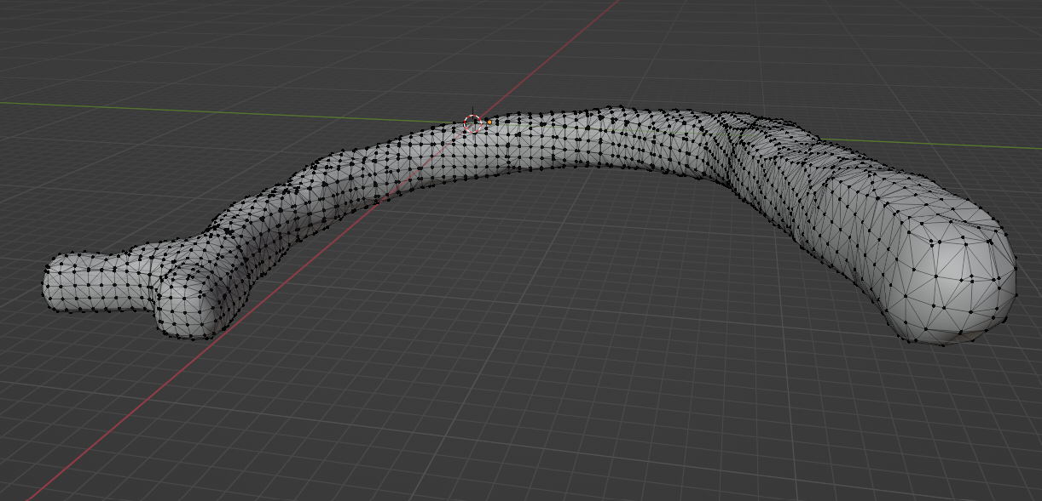
METHODOLOGY – 3D MODEL
Mesh Generation in CloudCompare
Mesh Data Blender
Emesent HoverMap Lidar Scans
Figure 21: 3D mesh of the East decline generated from point cloud data

Slide 41
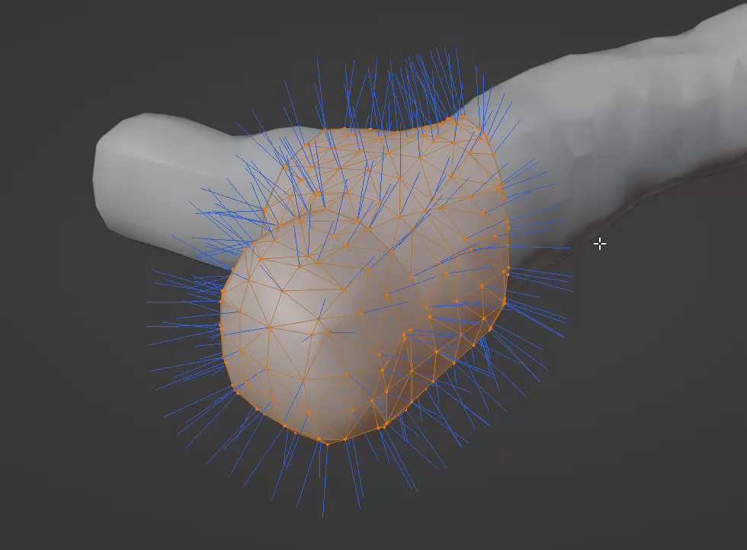
METHODOLOGY – 3D MODEL
The vertex position
The vertex normals
Figure 22: 3D Vertex normal of the concerned area of the 3D model of the East decline

Slide 42
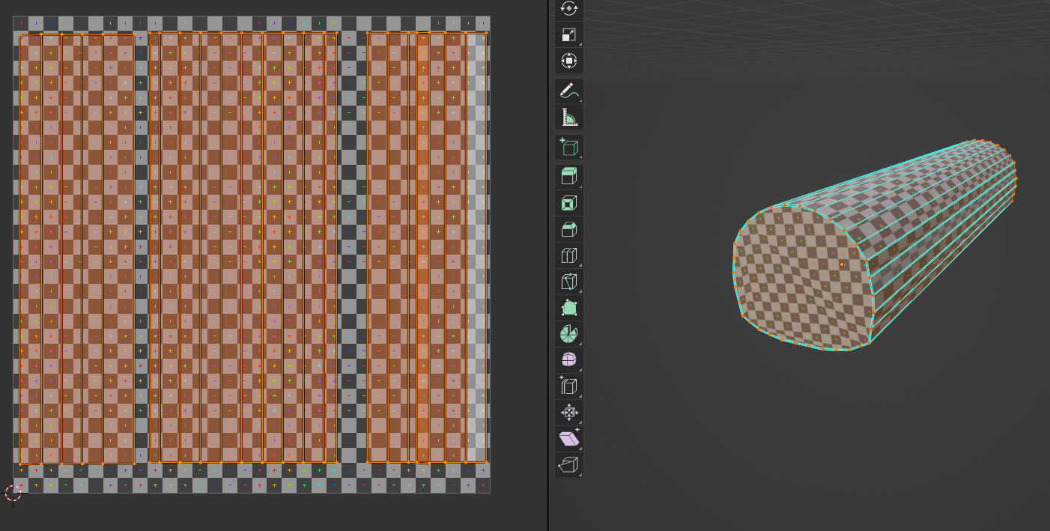
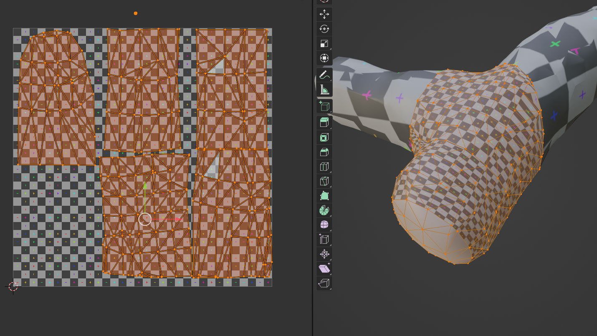
METHODOLOGY – SHADERS
Figure 23: The representative triangulations in texture 2D space
3D MODEL/MESH
SHADERS
Figure 24: The realistic triangulations in texture 2D space
RENDERING OF VISUALIZATION

Slide 43
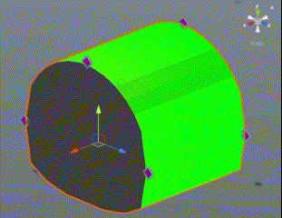
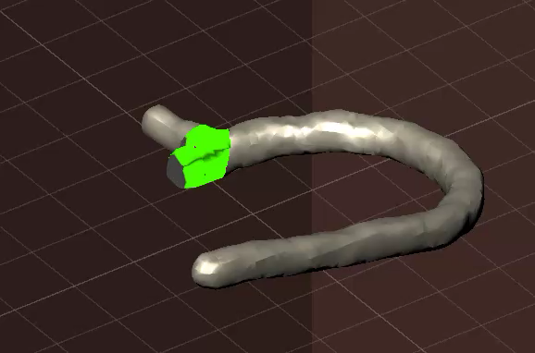
FINAL REAL TIME RENDERING
Figure 25: Real time rendering of data on a simplistic model
Figure 26: Real time rendering of data on a complex model

Slide 44
CONCLUSIONS
Notes:
17

Slide 45
CONCLUSION
Workflow
Overall Achievements:
A 3D visualization rock mass movement of underground openings in real time, is possible through following a logical framework.
Enhance Information Extraction
Reduce the Decision-Making Time,
Increase the Safety of a Mine

Slide 46
THANK YOU

Slide 47
QUESTIONS & DISCUSSION
Notes:
17

